Slide 1

MODULE 3
Shear Force and Bending Moment
By
Dr. s.jeyanthi
Professor

Slide 2
Outline
Types of Beams
Shear Force and Bending Moment
Relation between Load, Shear and Bending Moment
Problems for various Loads
  Cantilever Beam
  Simply Supported Beam
  Overhanging Beam

Slide 3
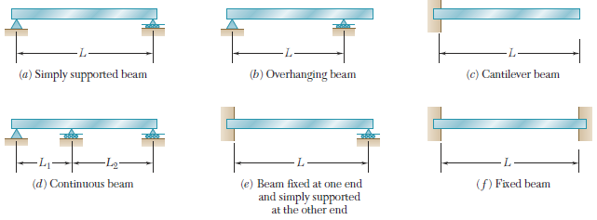
Types of Beams
Statically Determinate Beams
Statically Indeterminate Beams

Slide 4
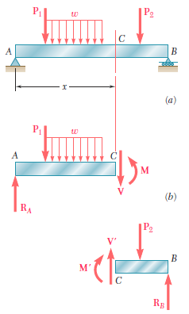
Shear Force and Bending Moment
The algebraic sum of the vertical forces at any section of a beam to the right or left of the section is known as shear force.
The algebraic sum of the moments of all the forces acting to the right or left of the section is known as bending moment.

Slide 5


Sign Convention (Positive sign)
Shear Force
Bending Moment

Slide 6
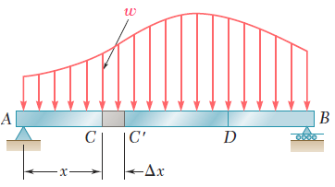



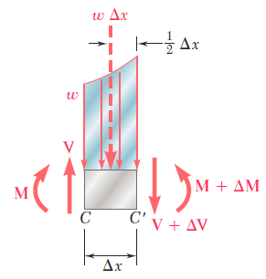

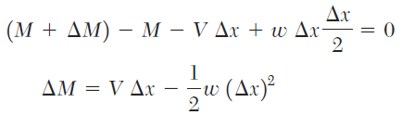

Relations among Load, Shear and Bending Moment

Slide 7
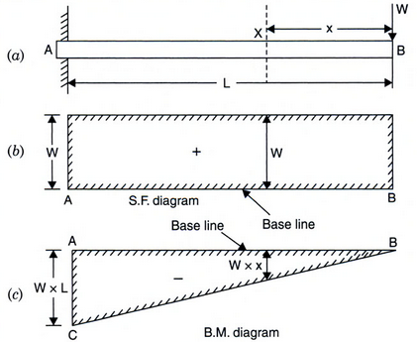




Problem 1
Cantilever Beams
Shear Force
$$V_{x}=+W$$
(Constant)
Bending Moment
$$M_{x}=−Wx$$
(Linear)
At x=0
$$M_{B}=0$$
At x=L
$$M_{A}=−WL$$

Slide 8
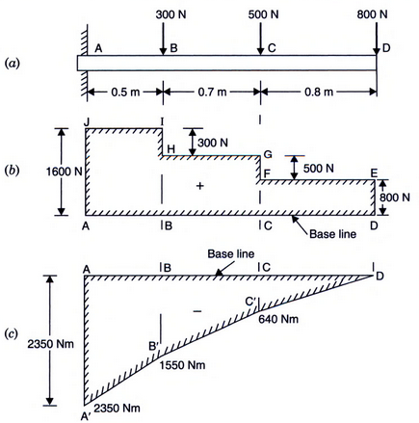
Problem 2
Cantilever Beams

Slide 9
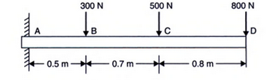
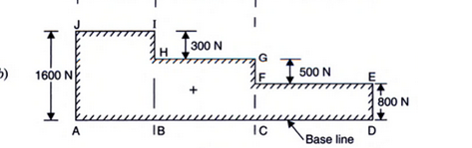

Slide 10
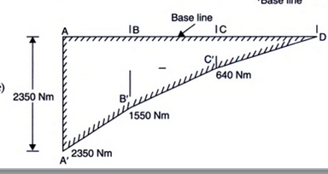

Slide 11
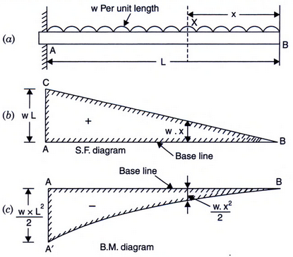
Problem 3
Cantilever Beams

Slide 12
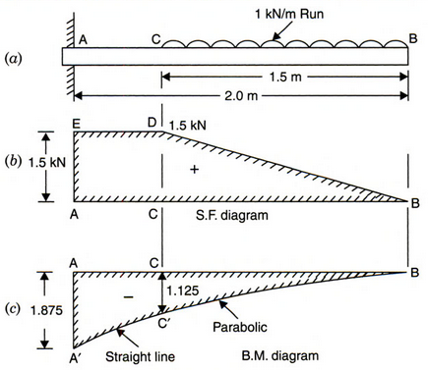
Problem 4
Cantilever Beams

Slide 13
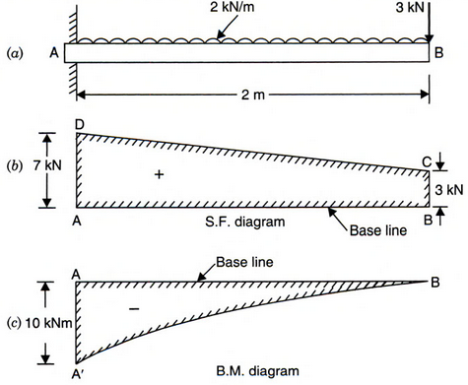
Problem 5
Cantilever Beams

Slide 14
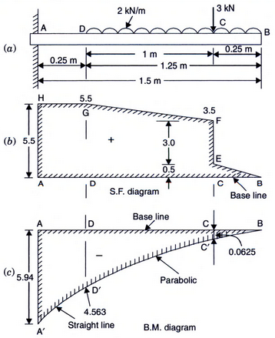
Problem 6
Cantilever Beams

Slide 15
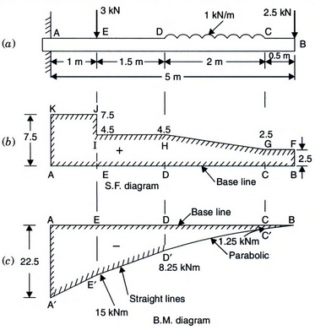
Problem 7
Cantilever Beams

Slide 16
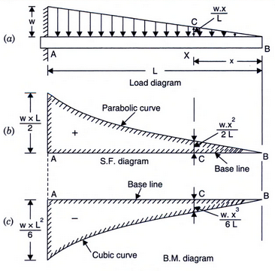
Problem 8
Cantilever Beams

Slide 17
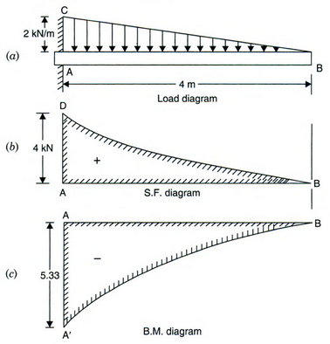
Problem 9
Cantilever Beams

Slide 18
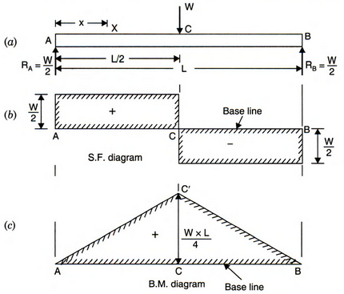
Problem 10
Simply Supported Beams

Slide 19
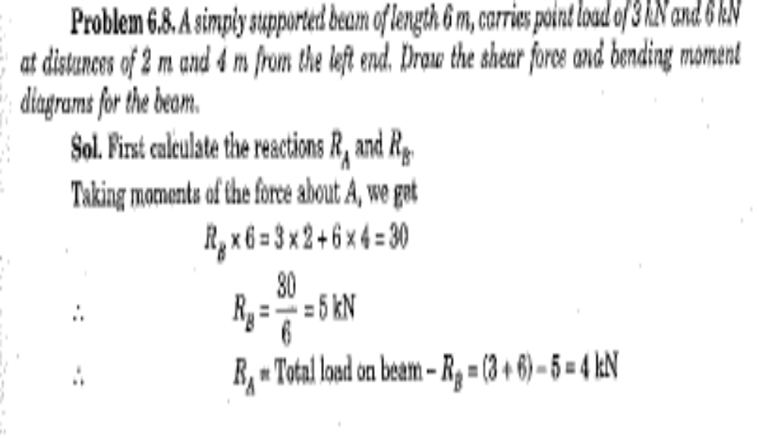
Simply supp beam problems

Slide 20
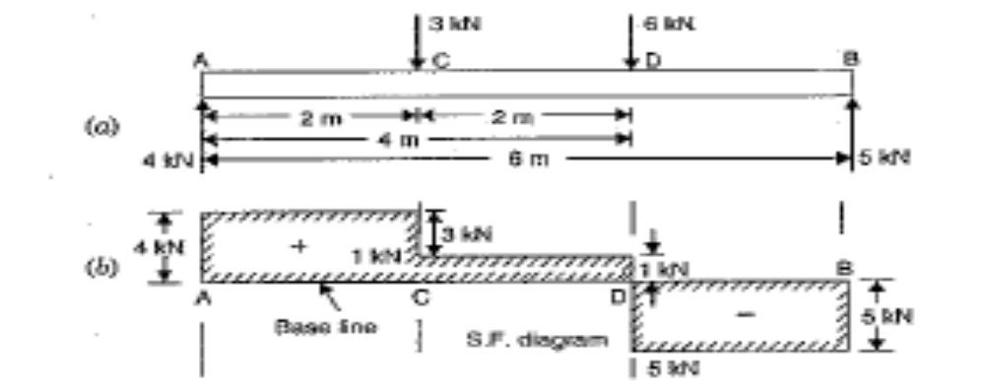
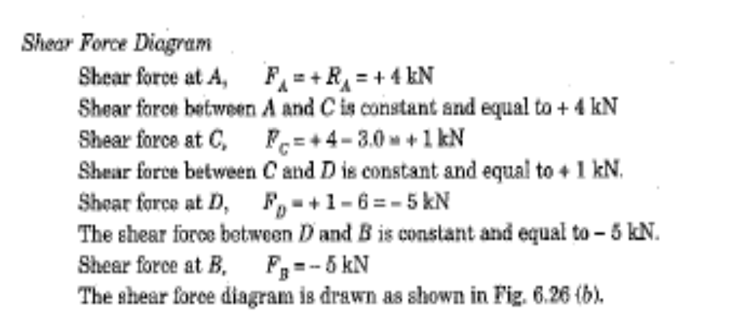

Slide 21
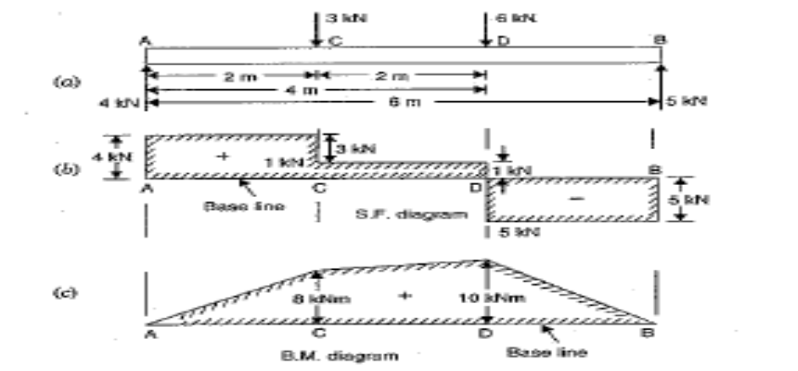
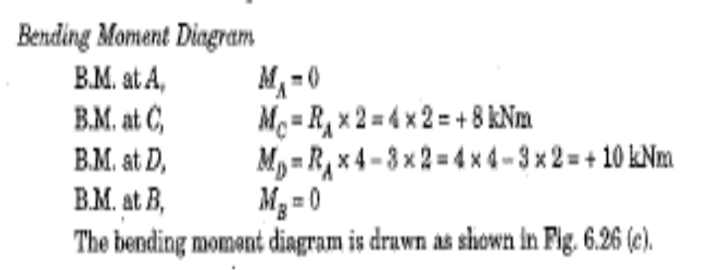

Slide 22
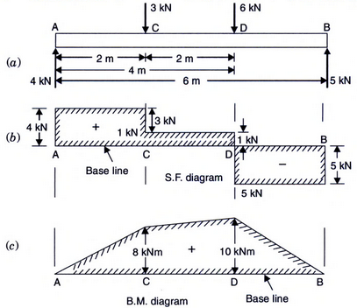
Problem 11
Simply Supported Beams

Slide 23
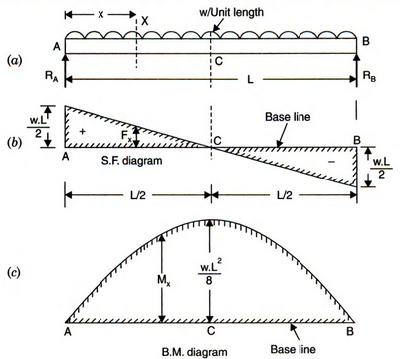
Problem 12
Simply Supported Beams

Slide 25
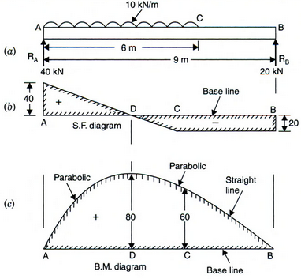
Problem 13
Simply Supported Beams
Ra+Rb=60KN
MOENT AT A
RB*9-60*3=0
RA=40
RB=20

Slide 26
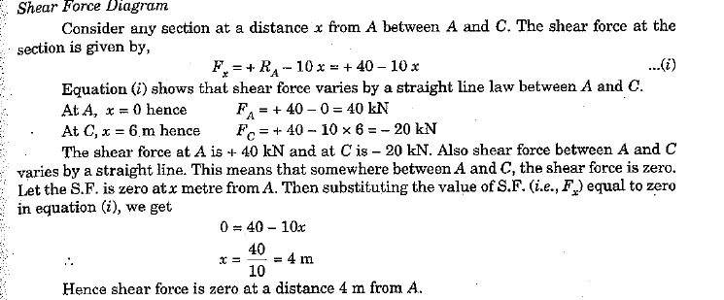

Slide 27
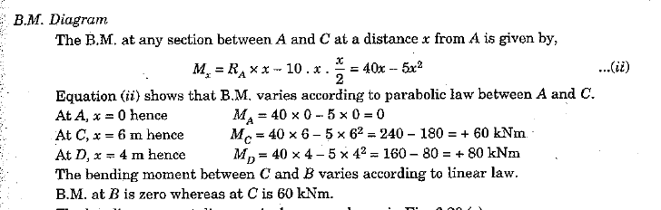

Slide 28
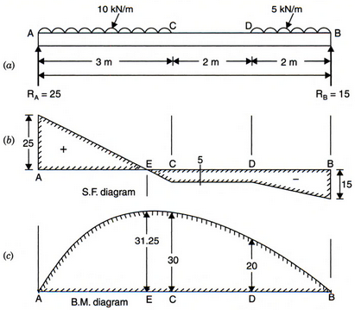
Problem 14
Simply Supported Beams

Slide 29
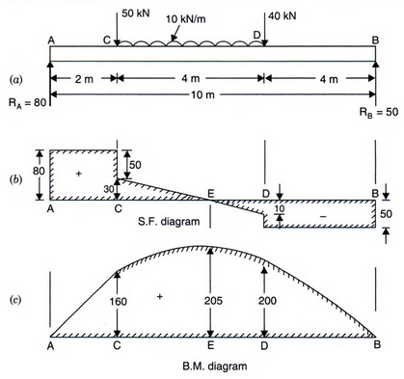
Problem 15
Simply Supported Beams

Slide 30
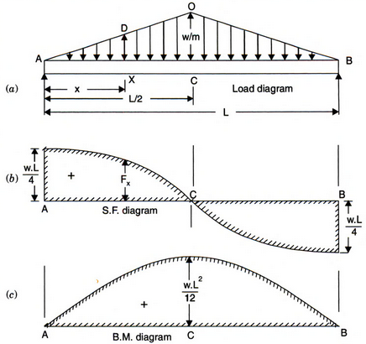
Problem 16
Simply Supported Beams

Slide 31
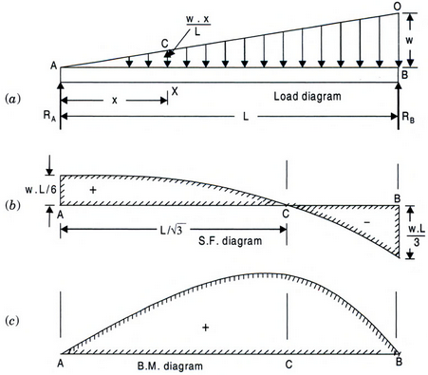
Problem 17
Simply Supported Beams

Slide 32
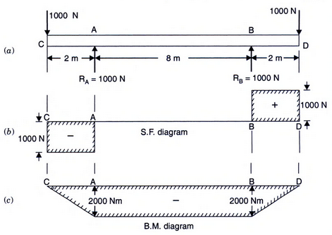
Problem 18
Overhanging Beams

Slide 33
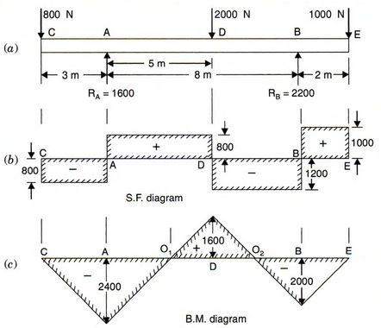
Problem 19
Overhanging Beams

Slide 34
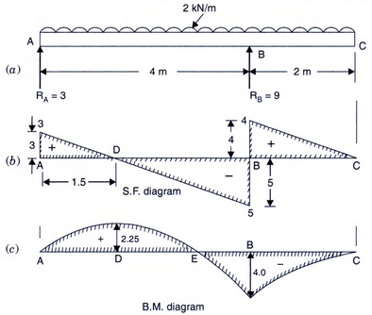
Problem 20
Overhanging Beams

Slide 35
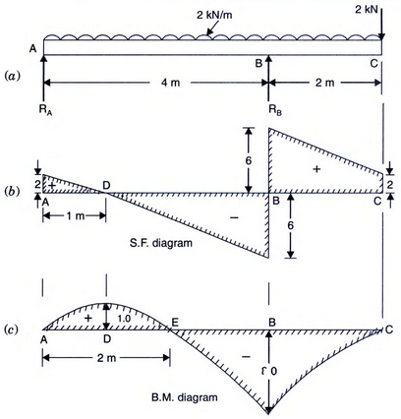
Problem 21
Overhanging Beams

Slide 36
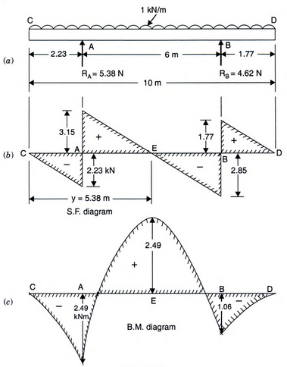
Problem 22
Overhanging Beams

Slide 37
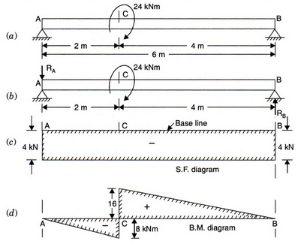
Problem 23
Overhanging Beams

